Slide 1
WWII Weather Analysis.
-Predicting Maximum Temperature from minimum Temperature Using Regression.
Name:-Shreya.R.Gurav
Rollno:-MSAS105

Slide 2
INTRODUCTION:-
Weather conditions played a critical role in World War II operations, often
influencing the timing and success of military missions. A famous example is the
D-Day landings, which were almost delayed due to poor weather forecasts.
This project explores historical weather data from that era to analyze the
relationship between daily minimum and maximum temperatures.
By building a simple linear regression model, we aim to predict maximum
temperature based on minimum temperature, and evaluate how well this model
performs using statistical metrics and visual insights.

Slide 3
Objectives:-
Build a regression model to predict the Temperature.
Analyse the relationship between minimum and maximum temperature.
Use Python to build a linear regression model.
Evaluate model performance using:
Mean Squared Error (MSE)
R² Score
Visualize actual vs. predicted temperature values.

Slide 4
DATA PREPARATION & MODEL BUILDING:-
Data Loading Cleaning :-By using pandas in python, the dataset of weather was loaded. The missing value were handled by using dropna() function.
Feature Selection:- The Min_temperature column was selected as independent variable to help predict the Max_temperature which was selected as dependent variable. Thus, the analysis was done using simple linear regression.
Model Building:- A linear regression model was creates using LinearRegression() from sklearn.linear_model

Slide 5
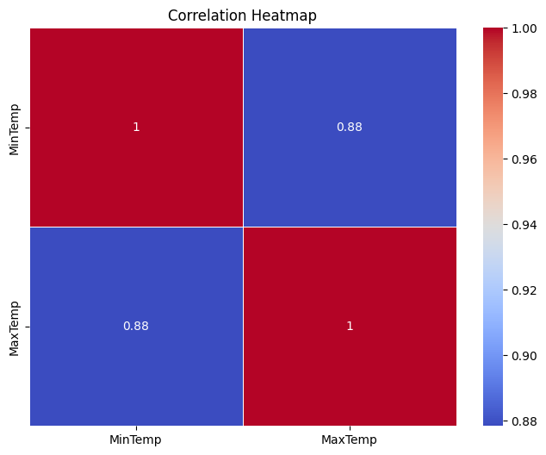
Correlation Analysis:-
The heatmap shows the correlation between daily weather variables.
In our case, the correlation between minimum and maximum temperature is high (e.g., 0.87).
This suggests that minimum temperature is a strong predictor of maximum temperature, making it suitable for linear regression modeling.

Slide 6
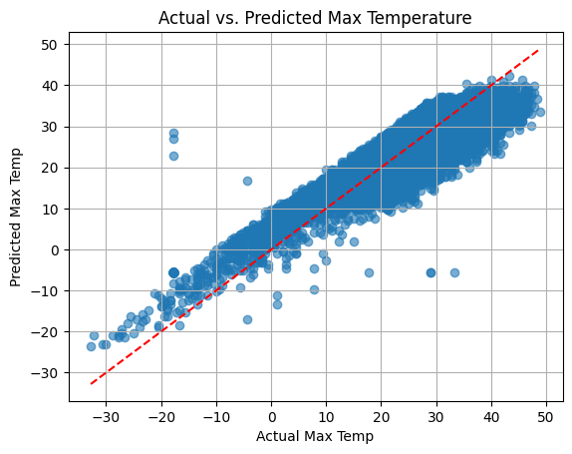
Evaluation & Visualization:-
R-square:0.7670
The R² score of 0.767 means that 76.7% of the variation in maximum temperature is explained by minimum temperature, indicating a strong linear relationship between the two.
Mean Squared Error (MSE):
MSE of 17.63 indicates reasonable accuracy, with some expected error due to using only one input variable.
The graph shows a strong linear relationship.
Points near the diagonal line indicate good predictions, though some outliers suggest adding more features could improve accuracy.

Slide 7
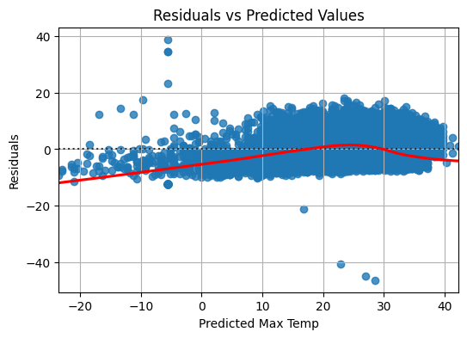
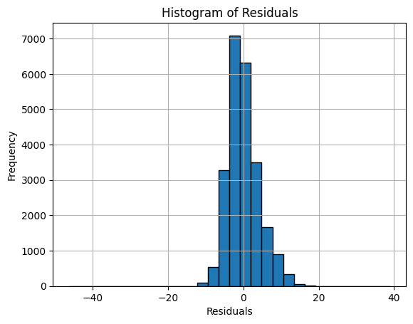
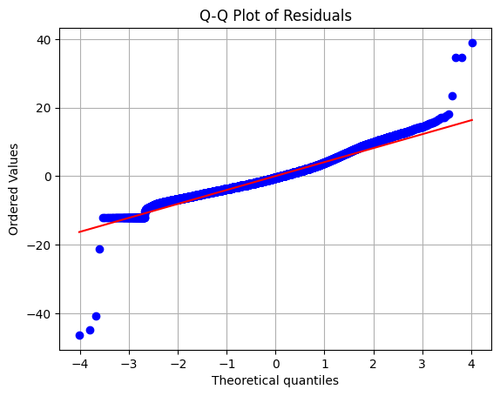
ASSUMPTIONS:-
Residuals are mostly centered around zero, indicating linearity is satisfied.
Slight spread suggests mild heteroscedasticity (non-constant variance).
Residuals are approximately normally distributed,
indicating the normality assumption is satisfied.
Most points lie on the straight line,
indicating residuals are approximately normal, with slight deviations at the extremes.

Slide 8
CONCLUSION:-
By using the simple linear regression in python, the maximum temperature
is predicted on the basis of minimum temperature. The R-square value is
0.767 i.e. with 76.7% of accuracy we can predict the values. The MSE value is
17.36. thus, we can say the predicted value is close to actual value though not
perfect. However, we can say the model build give good level of accuracy for
a single-variable regression. We know the 23.3% of variation is unexplained
as other factors like precipitation, WindGustSpd , MeanTemp, Snowfall,
Poor Weather is not considered. To increase the accuracy in actual and
predicted value we can used multiple linear regression.

Slide 9
BIBLOGRAPHY:-
DATASET: The Aerial Bombing Operations of World War Two dataset
Googlecolab : https://colab.research.google.com
LIBRARIES USED: pandas, sklearn.model_selection, sklearn.linear_model,
matplotlib.pyplot, sklearn.metrics,seaborn
PYTHON BASIC: https://www.python.org/
EDA processing: college notes.
THANK YOU!!

